Slide 1

PRESENTATION
AMAZON SALES
DATA ANALYSIS
SQL BASED
BY KUMARESH BISWAS

Slide 2
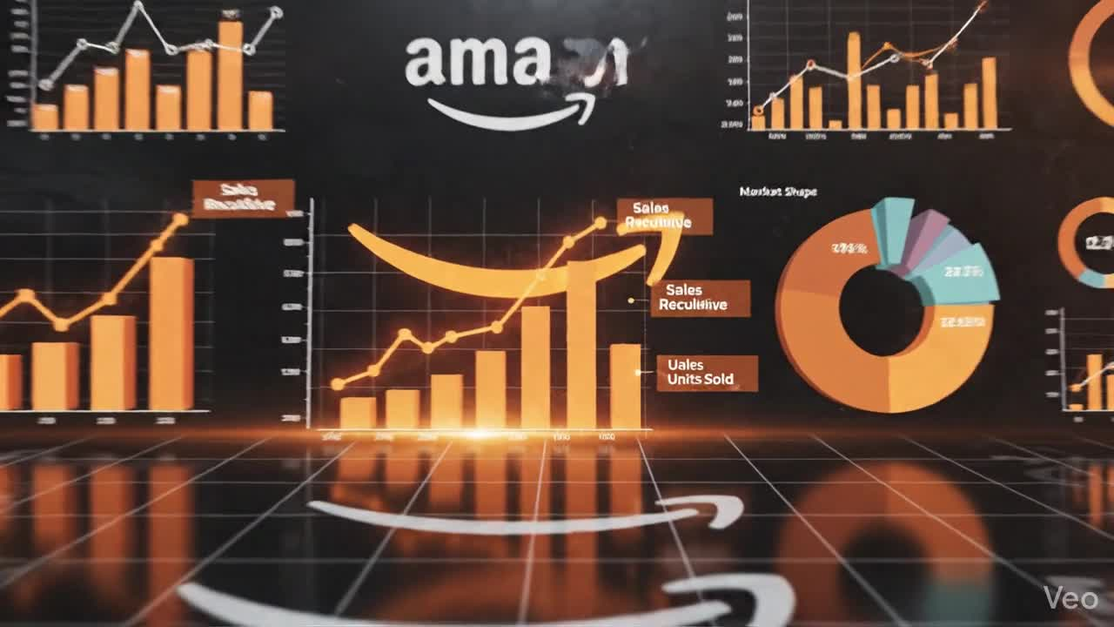

Slide 3

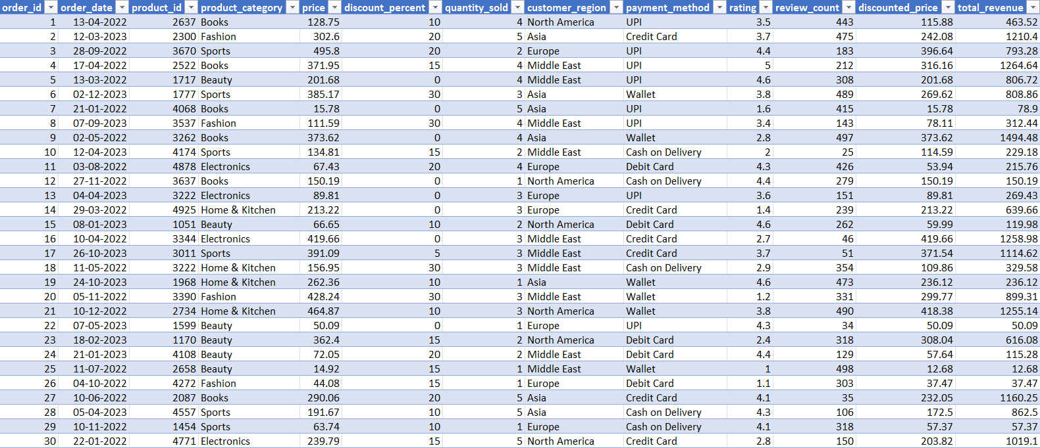
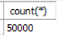
DATASET OVERVIEW
REFERENCE FROM - KAGGLE

Slide 4
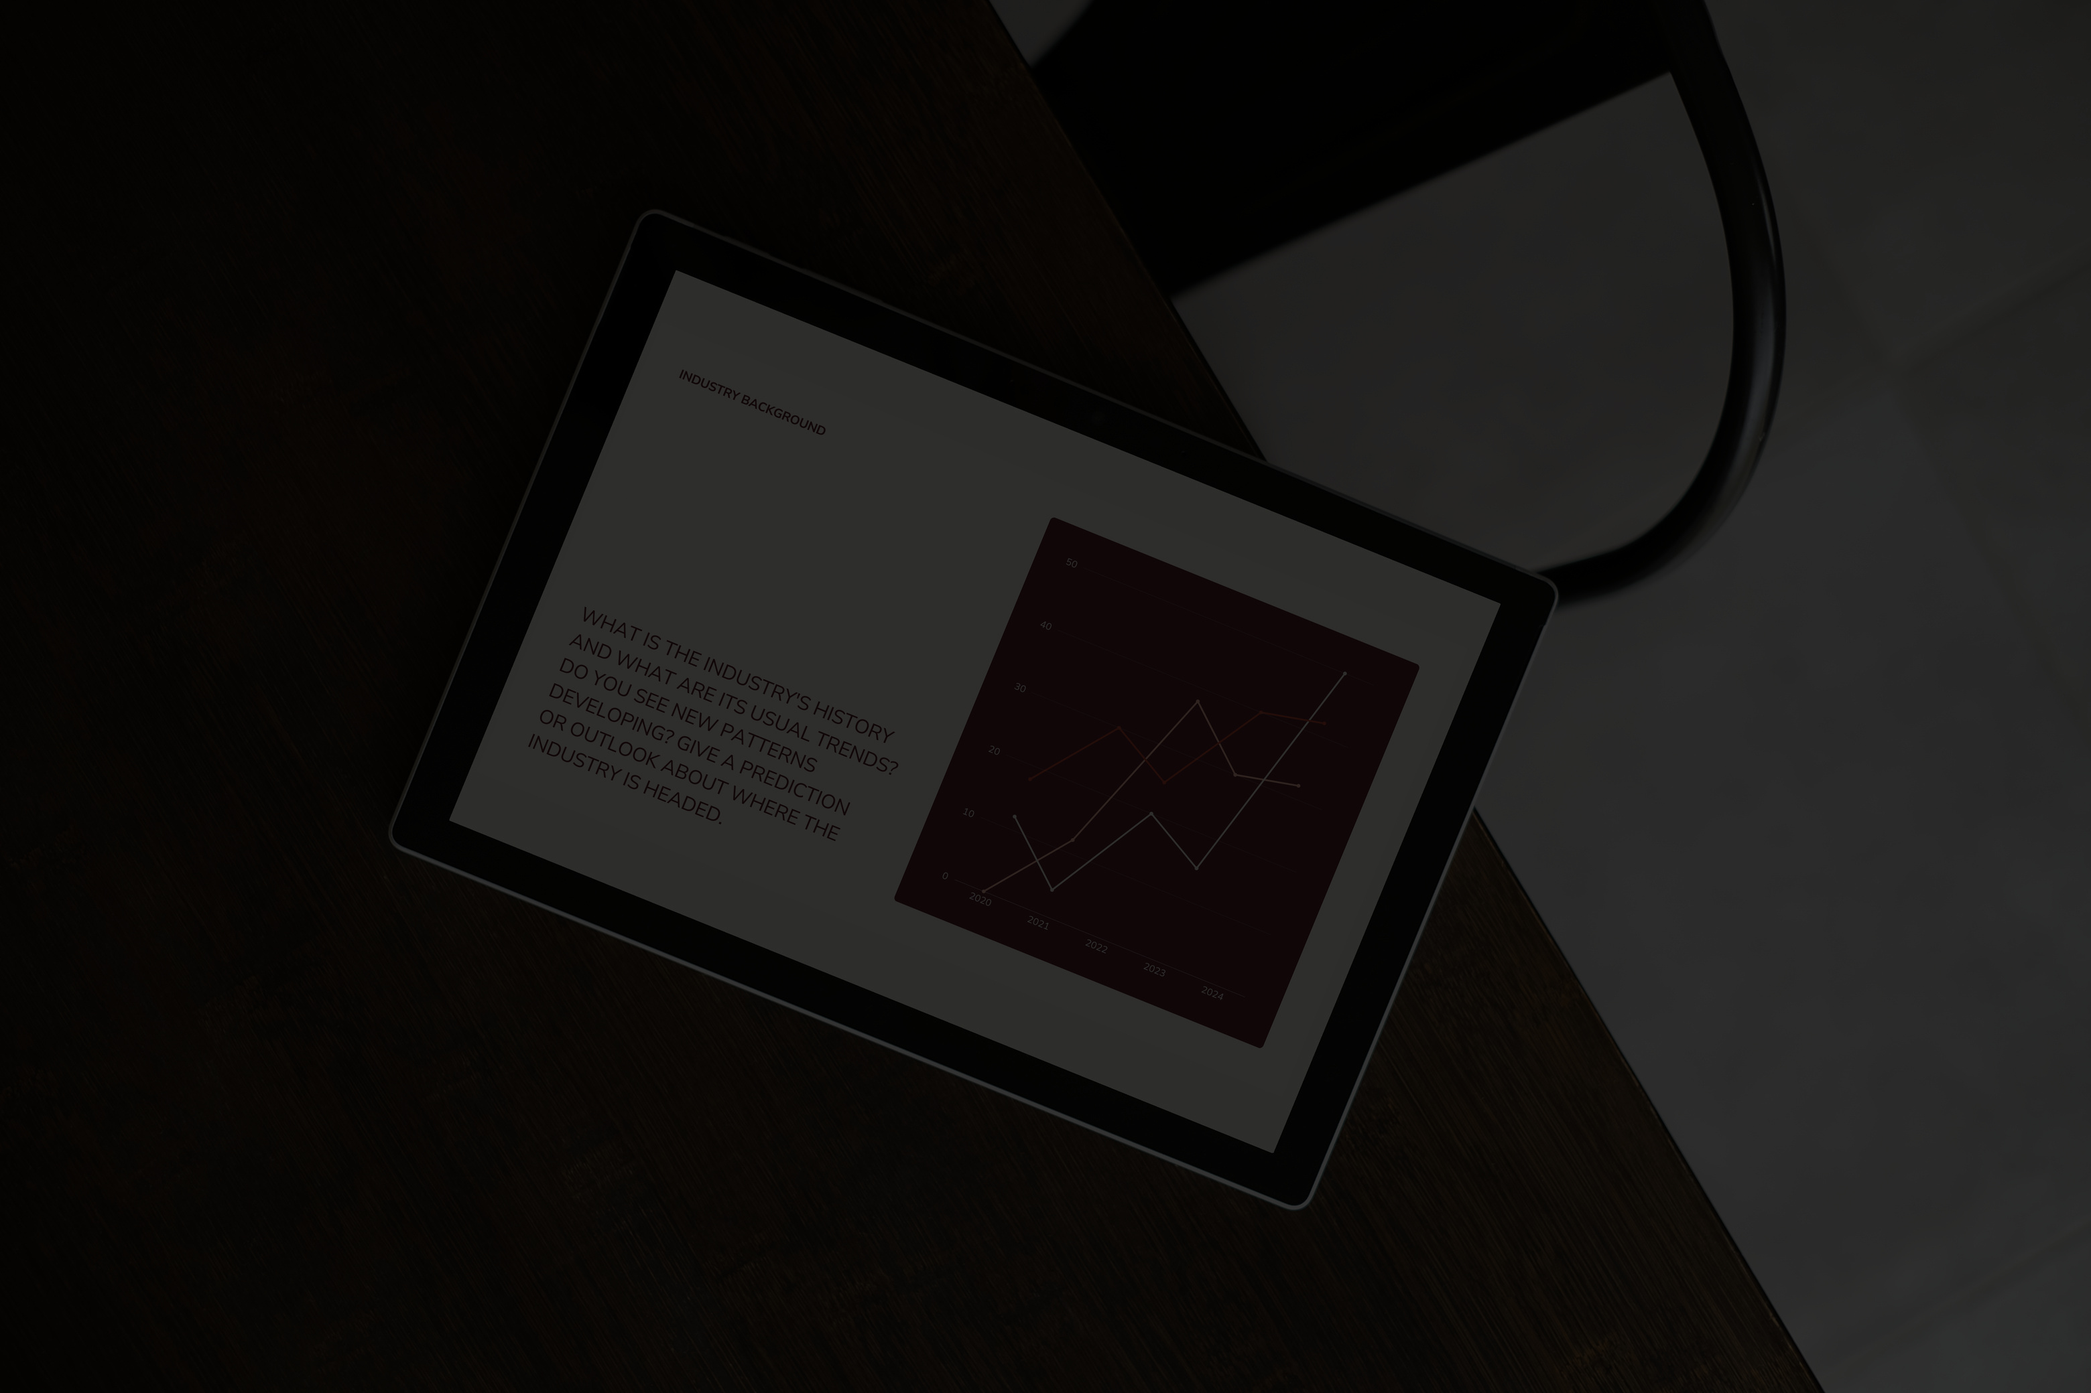
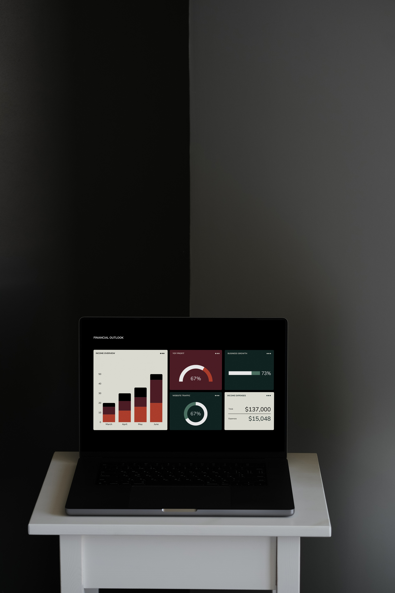
PROBLEM STATEMENT
This project analyzes a sales dataset using SQL to evaluate revenue trends, product performance, regional sales, and customer behavior. Various SQL techniques such as aggregation, joins, subqueries, and window functions were used to generate business insights.

Slide 5
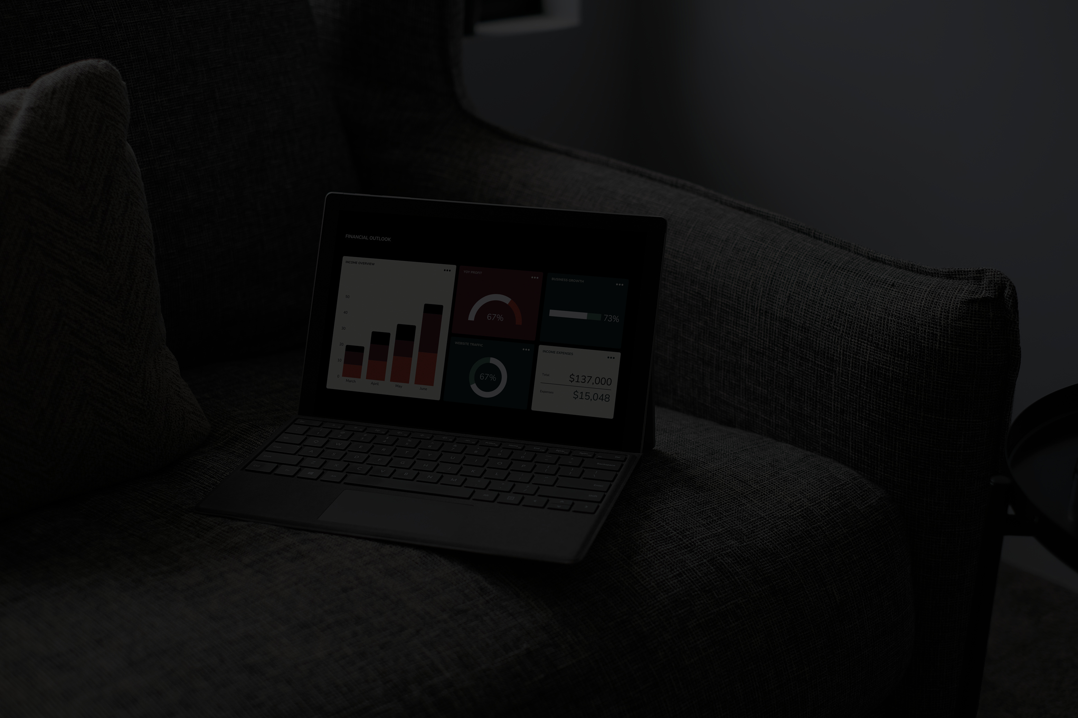
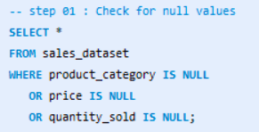
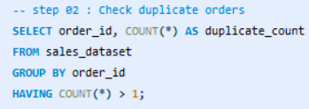
DATA CLEANING
SQL QUERIES:

Slide 6

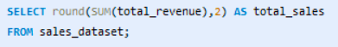
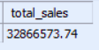
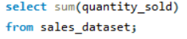
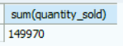
DATA ANALYSIS
TOTAL REVENUE
BASIC:
OUTPUT
TOTAL UNIT SOLD
OUTPUT

Slide 7
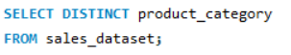
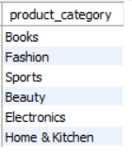
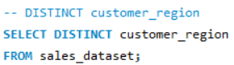
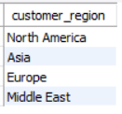
DISTINCT CATEGORY OF PRODUCT
DATA ANALYSIS
OUTPUT
BASIC:
DISTINCT CUSTOMER_REGION
OUTPUT

Slide 8

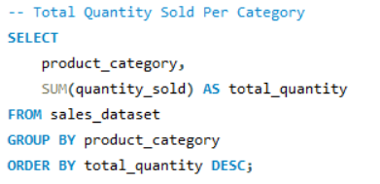

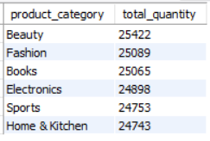
DATA ANALYSIS
AGGREGATION FUNCTIONS:

Slide 9
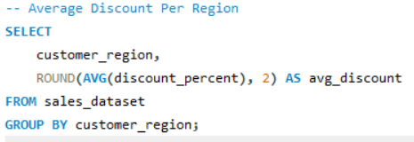
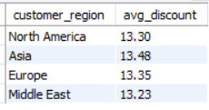
DATA ANALYSIS
AGGREGATION FUNCTIONS:

Slide 10
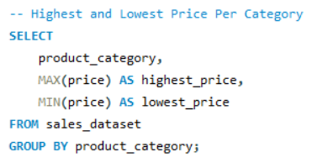
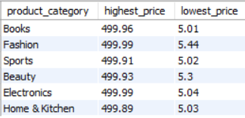
DATA ANALYSIS
AGGREGATION FUNCTIONS:

Slide 11
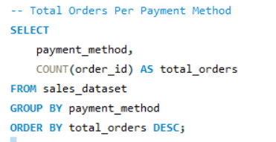
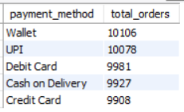
DATA ANALYSIS
AGGREGATION FUNCTIONS:

Slide 12
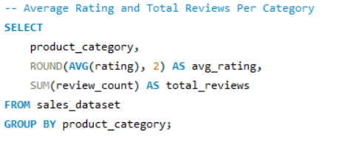
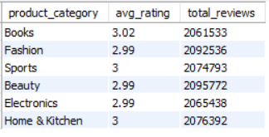
DATA ANALYSIS
AGGREGATION FUNCTIONS:

Slide 13

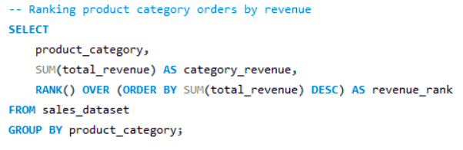
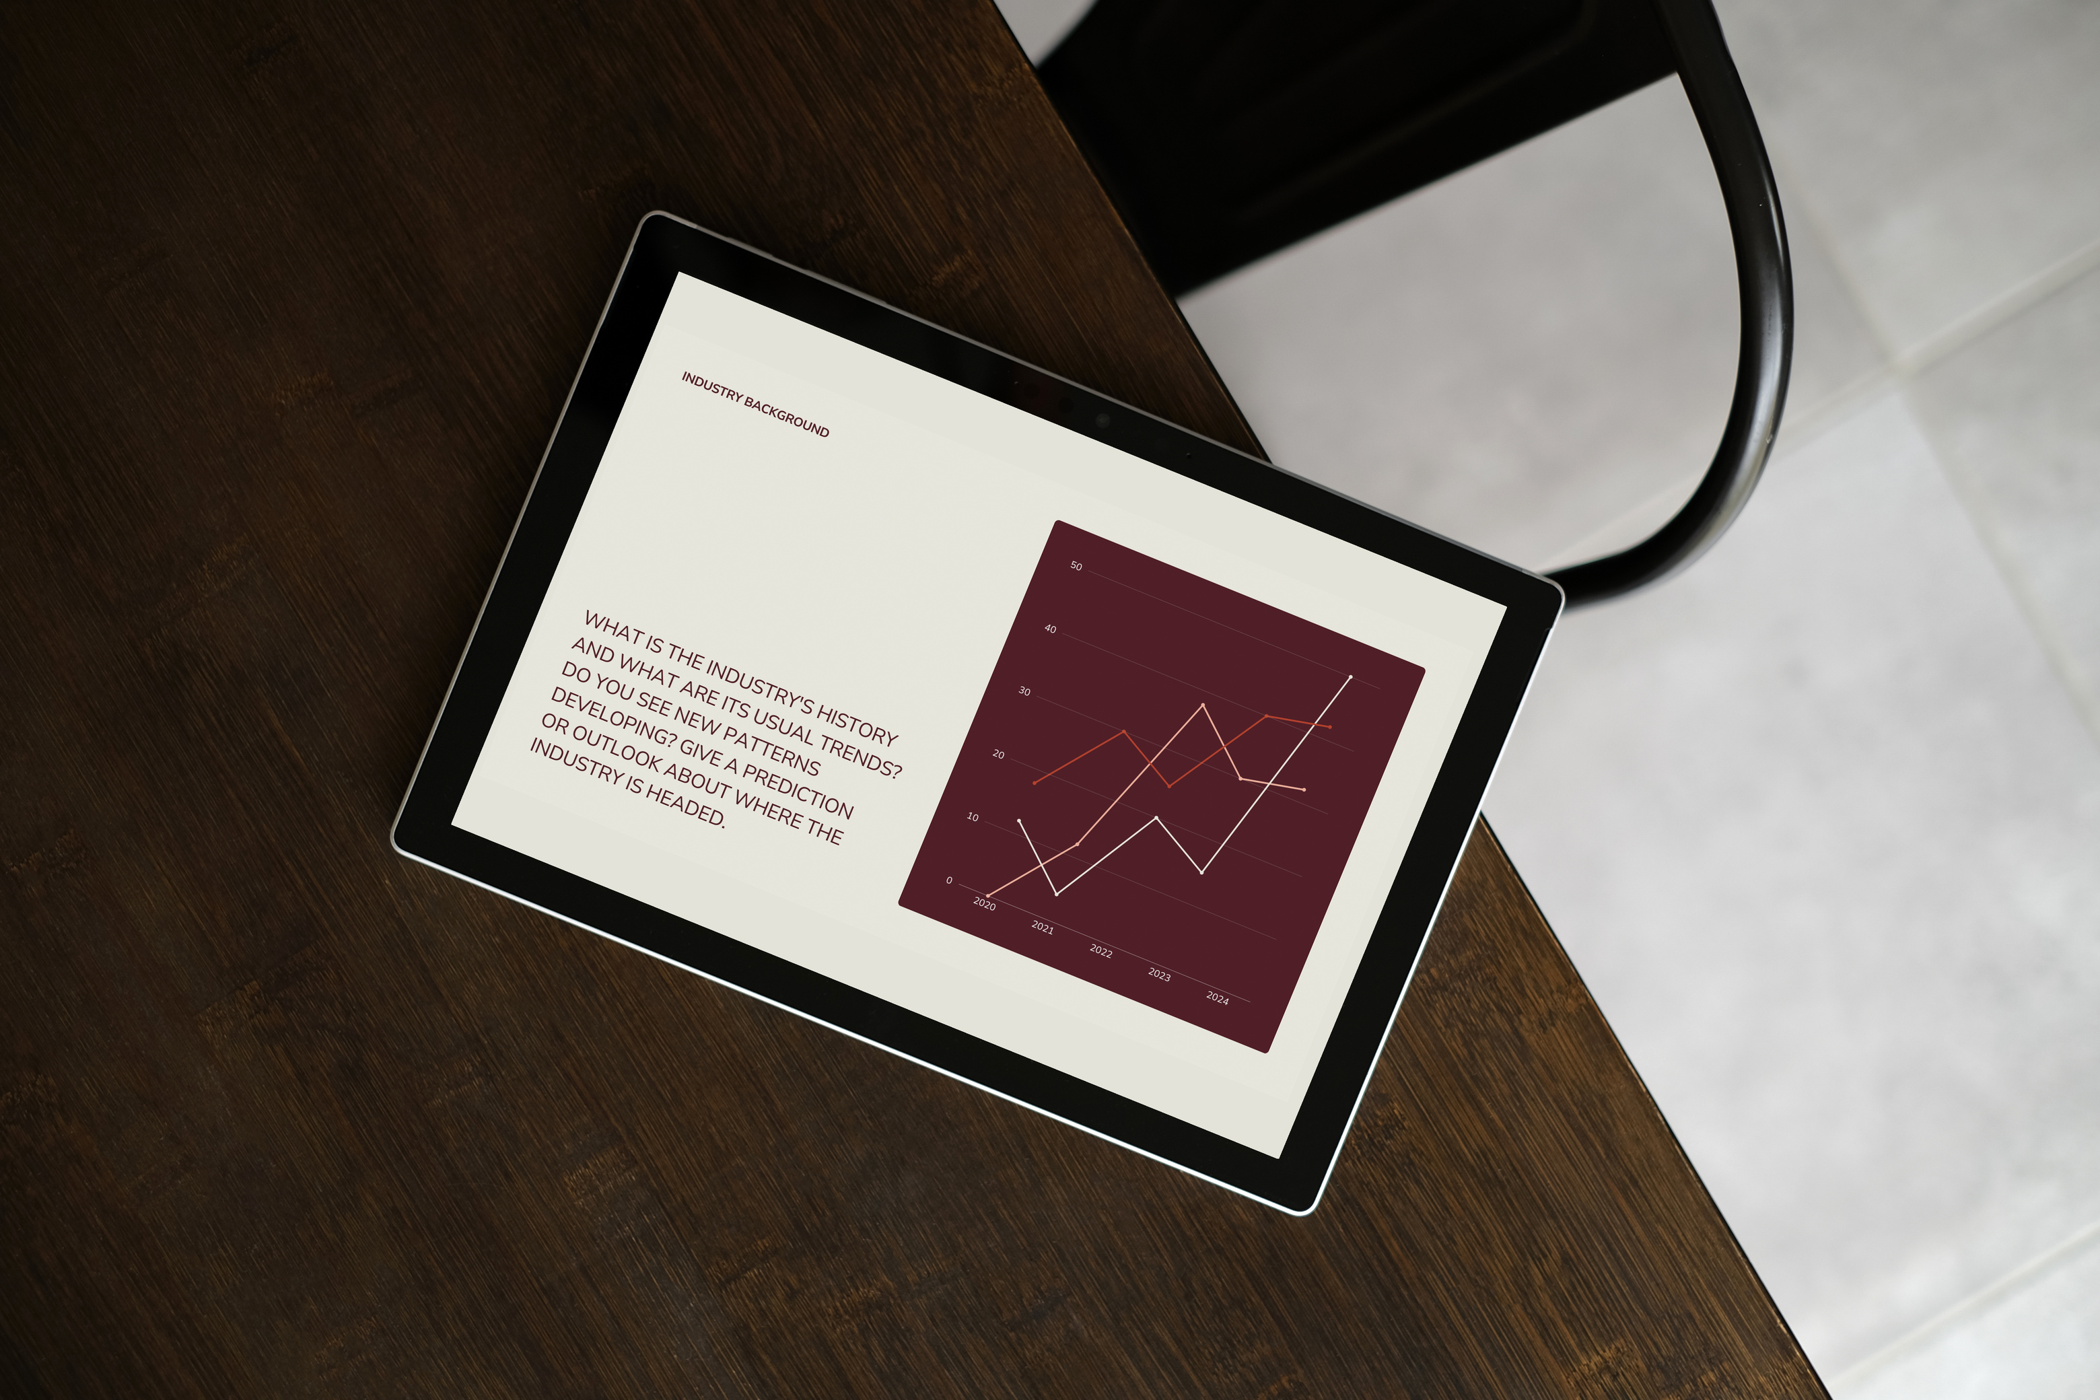
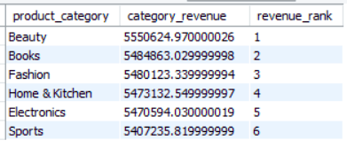
RANKING PRODUCT CATEGORY ORDERS BY REVENUE
DATA ANALYSIS
WINDOW FINCTIONS:
OUTPUT

Slide 14
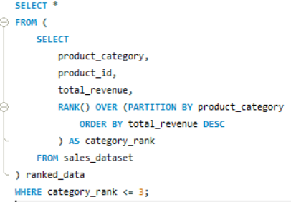
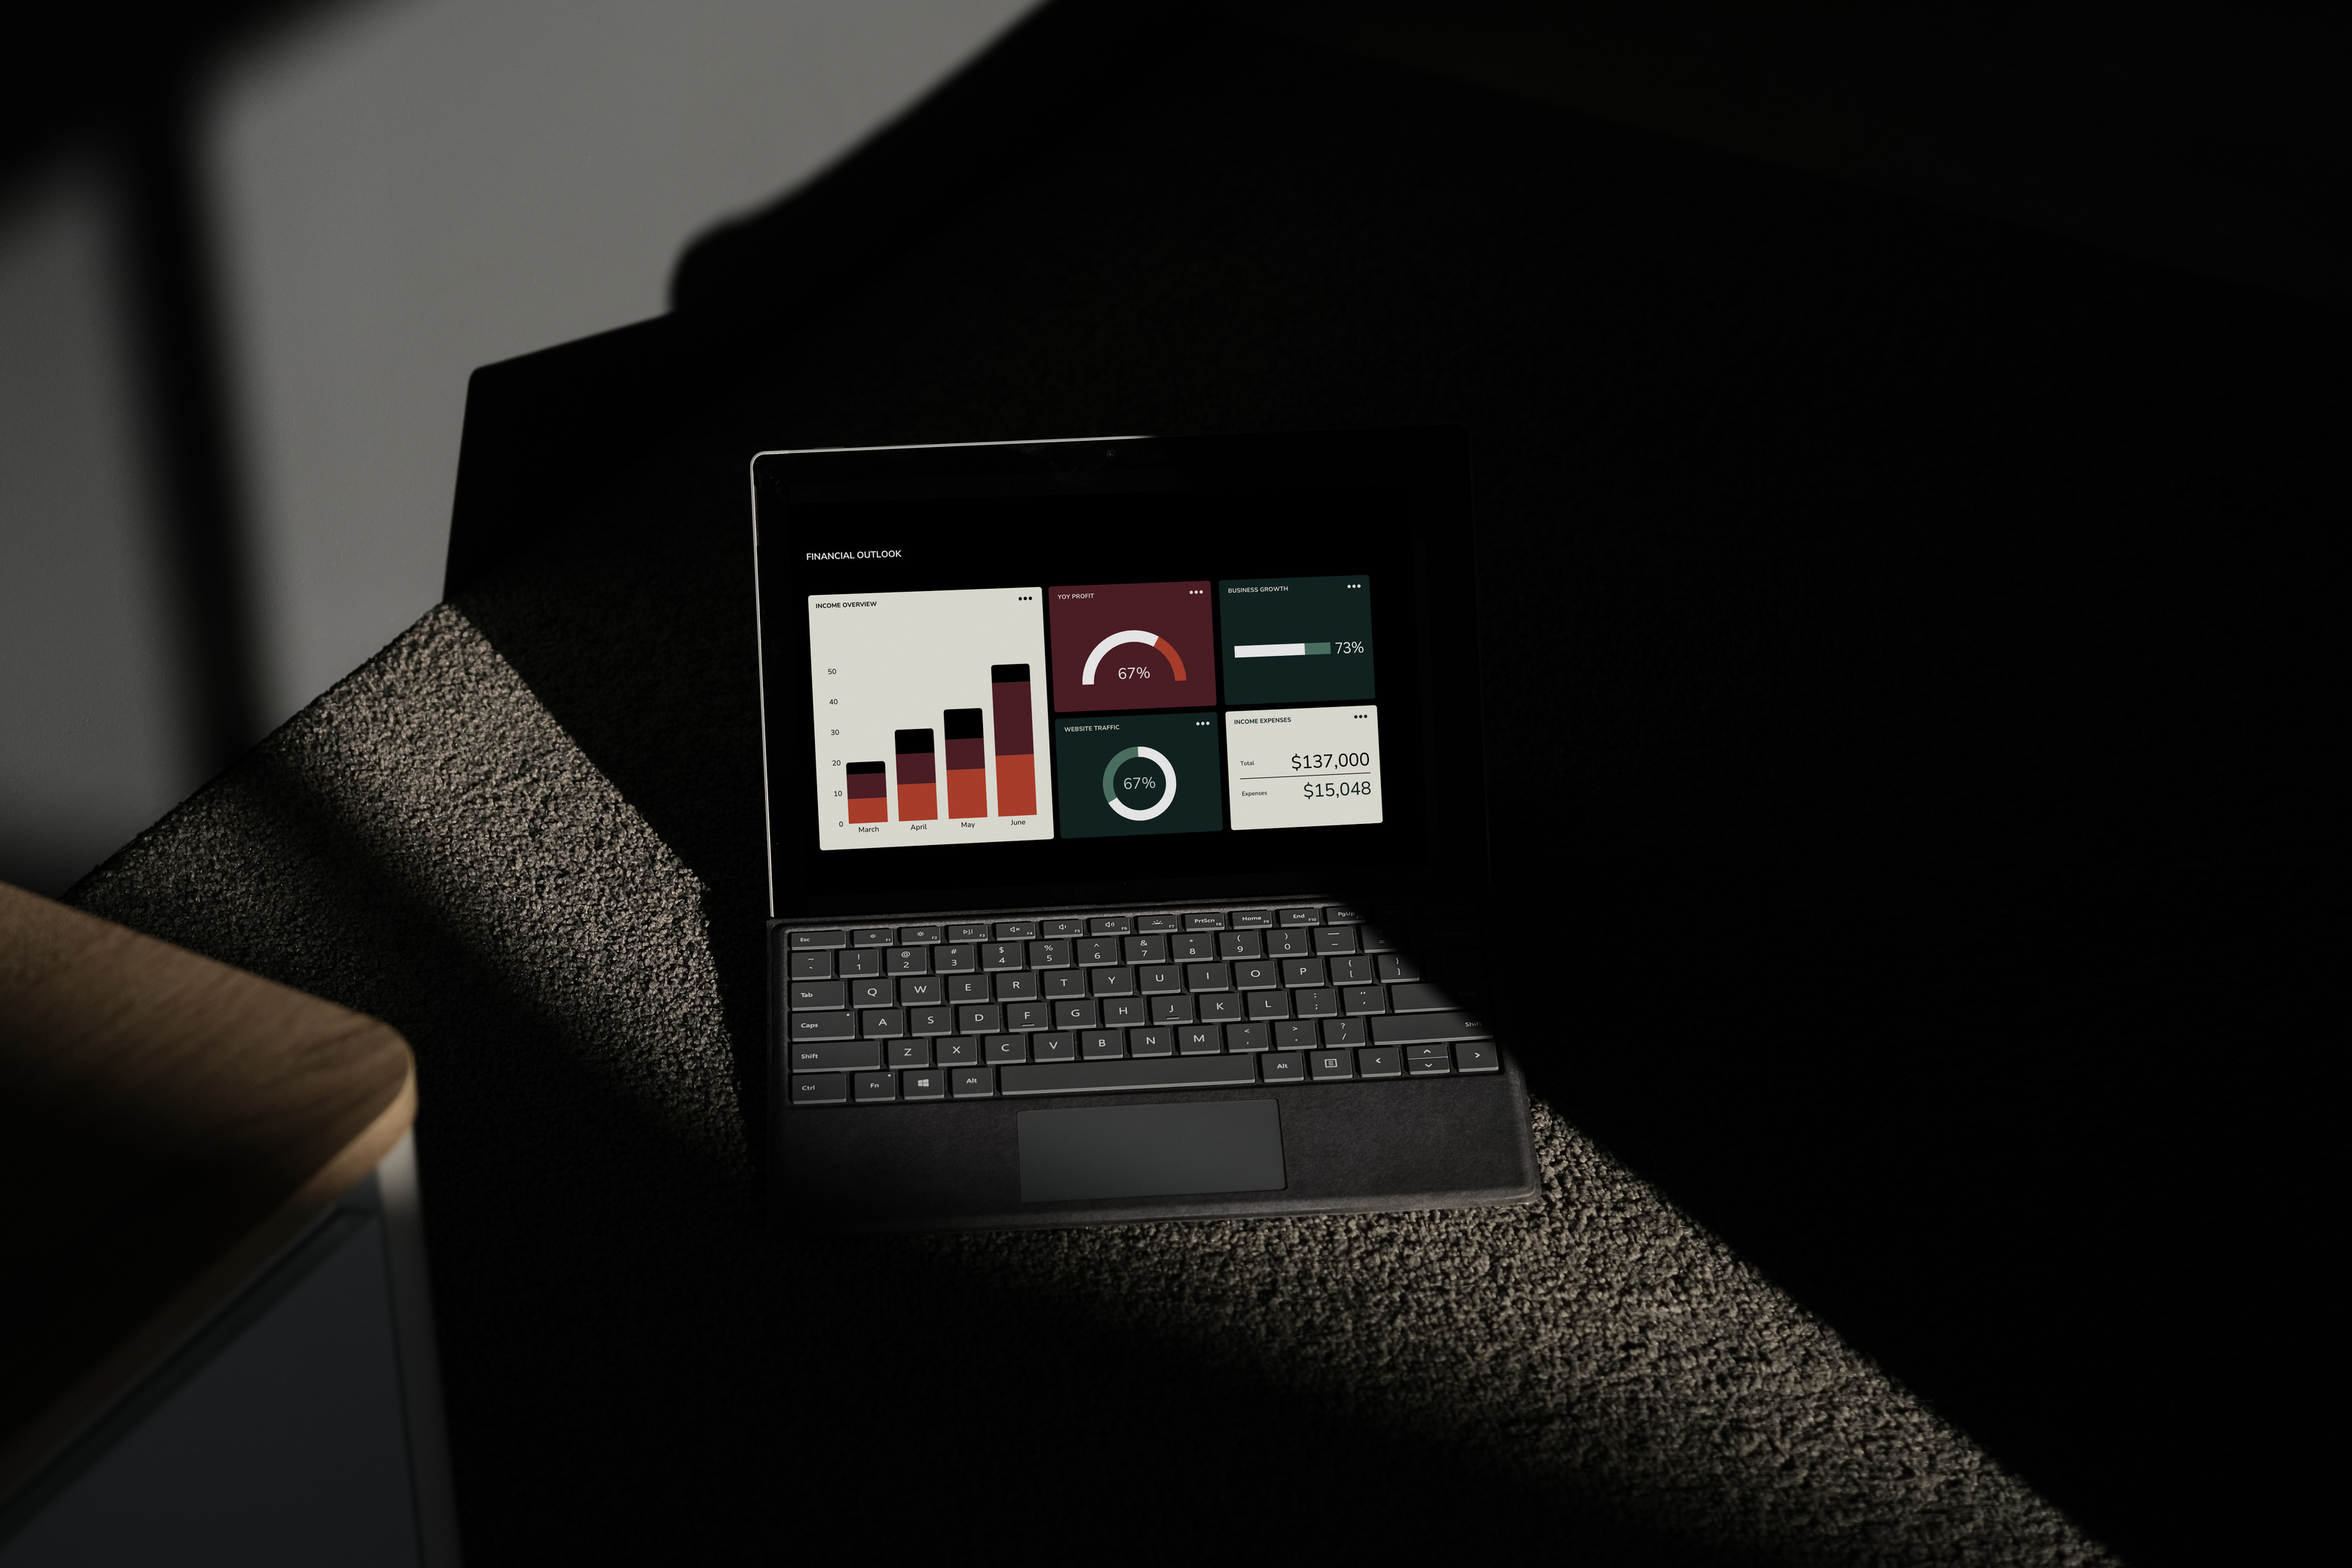
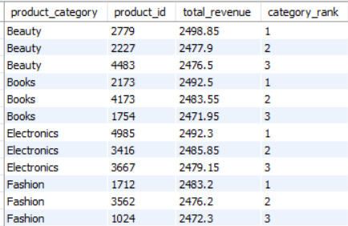
TOP 3 RANK PRODUCTS WITHIN EACH CATEGORY
DATA ANALYSIS
WINDOW FINCTIONS:
OUTPUT

Slide 15

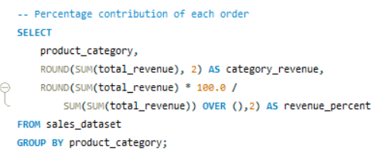
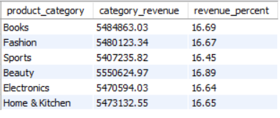
PERCENTAGE CONTRIBUTION OF EACH ORDER
DATA ANALYSIS
WINDOW FINCTIONS:
OUTPUT

Slide 16
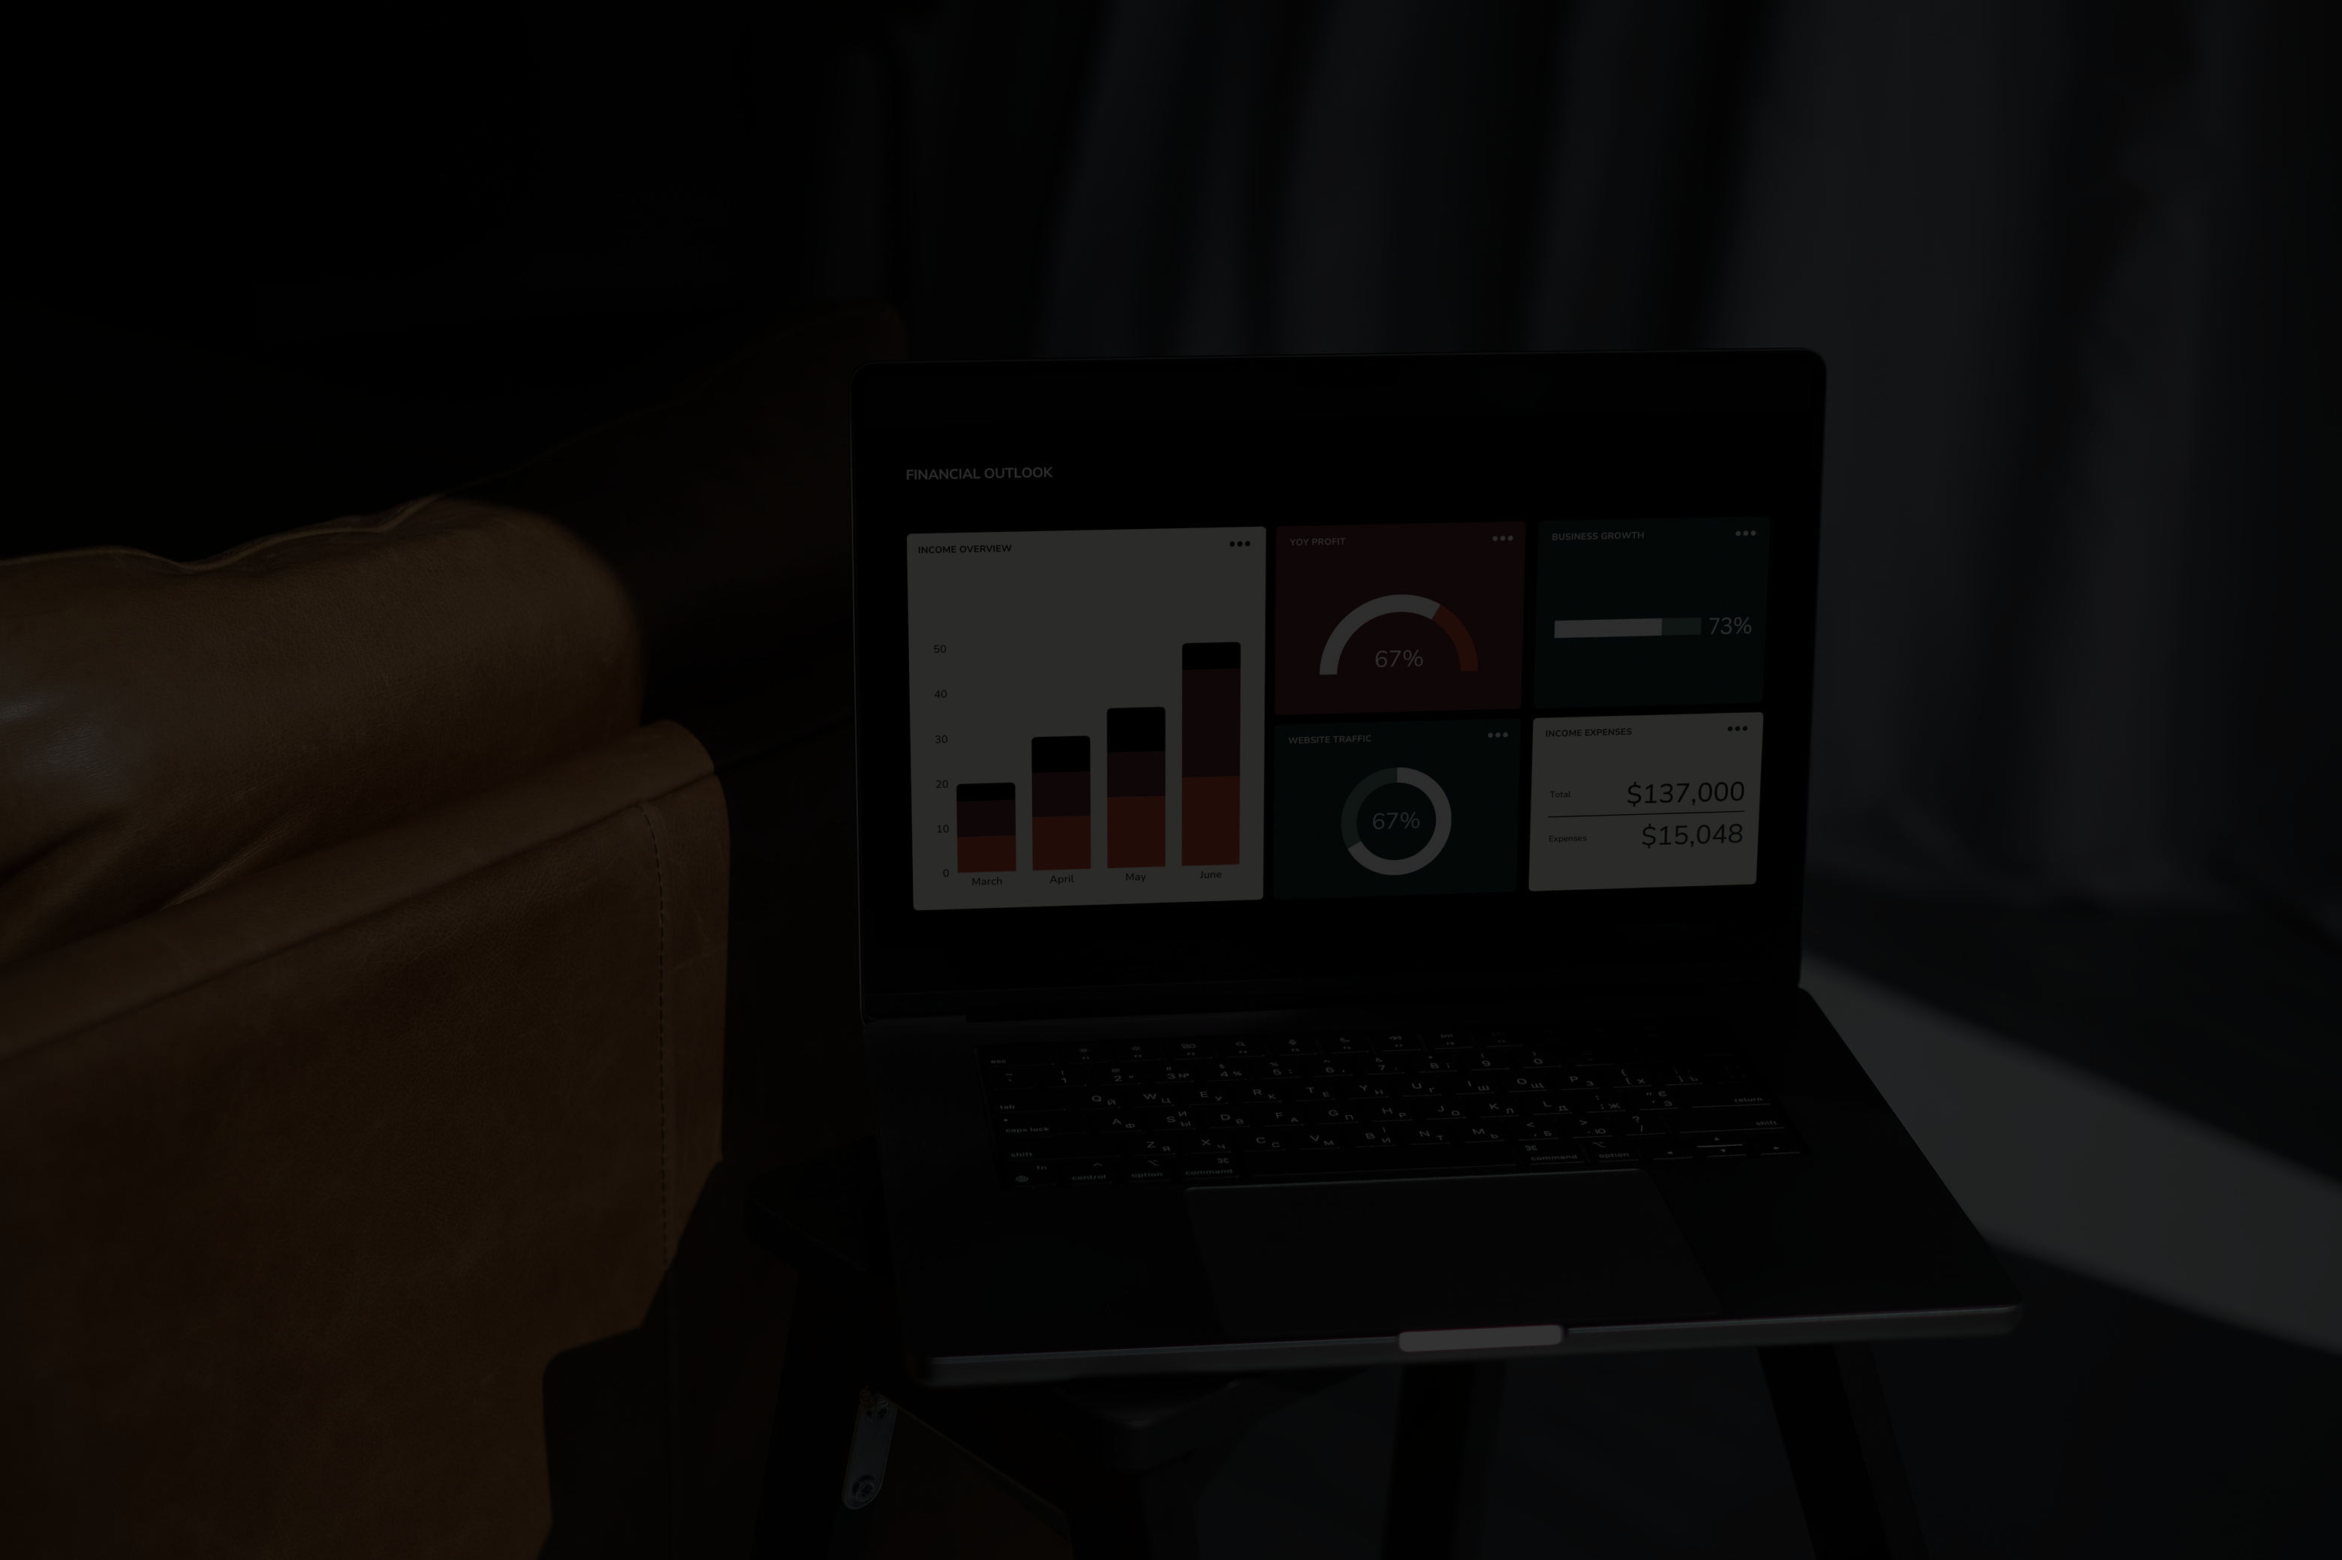
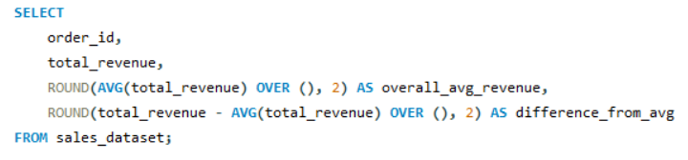
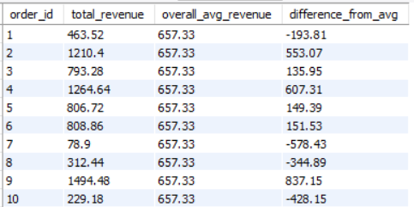
DATA ANALYSIS
REVENUE COMPARED TO OVERALL AVERAGE
WINDOW FINCTIONS:
OUTPUT

Slide 17
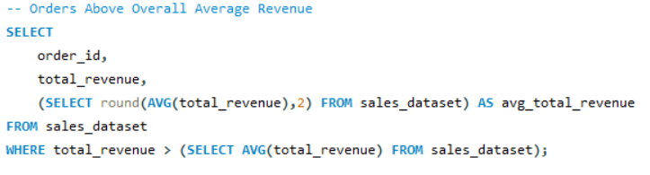
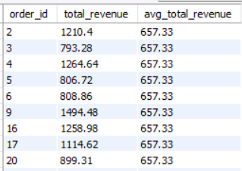
DATA ANALYSIS
ORDERS ABOVE OVERALL AVERAGE REVENUE
SUBQUERIES :
OUTPUT

Slide 18
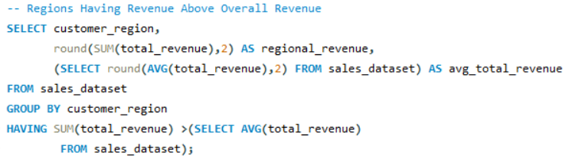
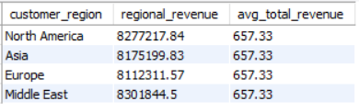
DATA ANALYSIS
REGIONS HAVING REVENUE ABOVE OVERALL REVENUE
SUBQUERIES :
OUTPUT

Slide 19
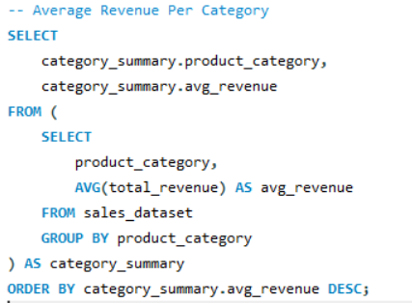
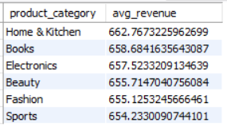
DATA ANALYSIS
AVERAGE REVENUE PER CATEGORY
SUBQUERIES :
OUTPUT

Slide 20
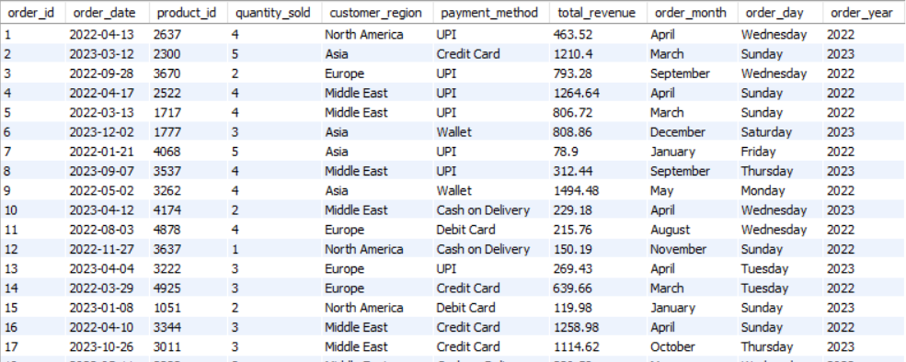
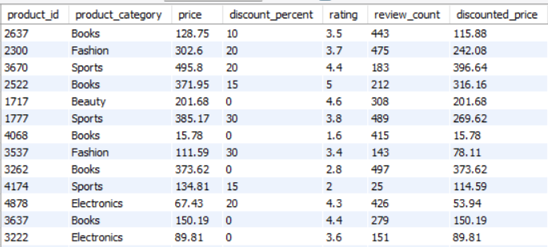
DATA ANALYSIS
TABLE OVERVIEW FOR JOIN
JOINS:
ORDERS
PRODUCTS

Slide 21
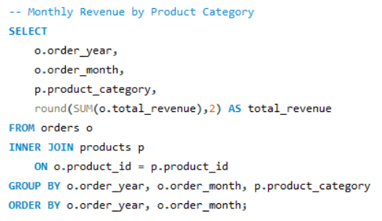
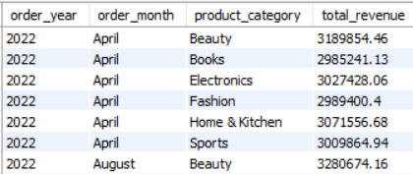
DATA ANALYSIS
JOINS:

Slide 22
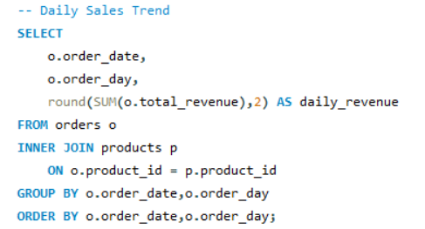
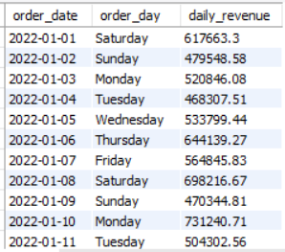
DATA ANALYSIS
JOINS:

Slide 23
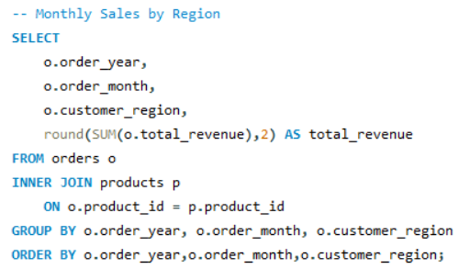

DATA ANALYSIS
JOINS:

Slide 24


DATA ANALYSIS
JOINS:

Slide 25


DATA ANALYSIS
JOINS:

Slide 26
CONCLUSIONS
AMAZON SALES ANALYSIS
The analysis transformed raw sales data into meaningful insights, identifying key revenue drivers and performance patterns. The project demonstrates strong practical knowledge of SQL for real-world data analysis and decision-making.

Slide 27

BY KUMARESH BISWAS
THANK YOU
FOR YOUR ATTENTION

